Slide 1

The Digital Complaint Box
Addressing the critical need for a secure and anonymous channel, this presentation outlines a digital platform designed to empower college students to voice concerns and suggestions without fear, fostering a more responsive and supportive academic environment.
BY ZERO FACTORIAL TEAM
MEMBER 1 : ABHINAV GUPTA
MEMBER 2: KUNAL NIRMALKAR
MEMBER 3: SURYANSH SAHU

Slide 2
The Problem: Unheard Student Concerns
College students often find it hard to share their problems or suggestions with college authorities. Many are scared of punishment, being judged by others, or feel that no one will listen. Because of this, important issues remain unsolved, chances to improve the campus are missed, and students feel distant from the administration. Whether it’s about safety, academics, or other concerns, there should be a safe and anonymous way for students to speak up.
Fear of Retribution
Lack of Trust
Unaddressed Issues
Students hesitate to speak up due to potential negative consequences.
Skepticism about the confidentiality and effectiveness of existing channels.
Important problems go unnoticed, impacting student well-being and campus life.

Slide 3

Our Solution: A Secure Digital Complaint Box
We propose a user-friendly, web and mobile-accessible platform that serves as a digital complaint box. Students can securely and anonymously submit issues ranging from academic concerns to campus environment suggestions. The platform ensures data encryption and masked identities, with a streamlined process for authorities to receive, categorize, and respond to feedback. This fosters a transparent and proactive approach to student welfare.
1
Anonymous Submission
Students can submit feedback without revealing their identity.
2
Secure Communication
End-to-end encryption protects all submitted data.
3
Direct Channel
Feedback goes directly to relevant college authorities.
4
Tracking & Resolution
Students can anonymously track the status of their submissions.

Slide 4





Technical Foundations
Our platform is built on a robust, modern tech stack designed for scalability, security, and ease of development. This combination ensures a seamless user experience while providing powerful backend capabilities for managing submissions.
HTML
CSS
JavaScript
Structuring the web content.
Styling the user interface for responsiveness.
Enabling interactive and dynamic features.
Node.js
n8n
Powering the backend server and APIs.
Automating workflows and integrations for efficient processing.

Slide 5
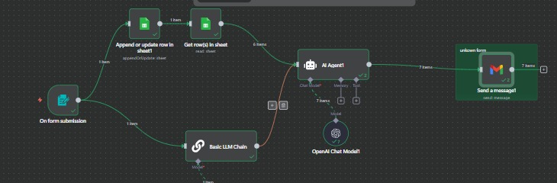
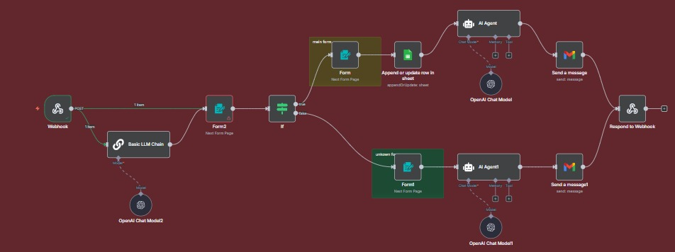
System Architecture & UI Flow
The platform's architecture is designed for clarity and efficiency, ensuring that student feedback is securely transmitted and effectively managed.
Architectural Overview
User Interface Flow
Front-end: HTML, CSS, JavaScript for responsive UI.
Login/Access: Students access the platform via web or mobile.
Backend: Node.js handles requests and data processing.
Submit Form: Fill out a simple, anonymous complaint/suggestion form.
Database: Securely stores anonymized submissions.
Encryption: Data is encrypted and anonymized upon submission.
Workflow Automation: n8n connects services and notifies authorities.
Workflow Trigger: n8n automates routing to relevant departments.
Authority Review: Designated personnel review and act on feedback.

Slide 6
Challenges & Key Learnings
Developing an anonymous platform presented unique challenges, particularly around ensuring true anonymity while maintaining accountability and preventing misuse.
Ensuring True Anonymity
1
Protecting student identity while allowing honest feedback.
Preventing Misuse
2
Avoiding fake, harmful, or spam complaint.
Data Security
3
Safeguarding sensitive information from leaks or hacks.
Balancing Accountability
4
Maintaining trust while ensuring genuine issues are addressed.

Slide 7





Future Scope & Enhancements
Our vision extends beyond the current platform, with several exciting features planned to further enhance its utility and impact.
Analytics Dashboard
Anonymous Chat Feature
Automated Notifications
For authorities to identify recurring issues and trends, facilitating proactive problem-solving.
Allowing authorities to anonymously request more details from the student if needed for investigation.
Alerting students (anonymously) when their submission status changes or when similar issues are resolved.
Multi-Language Support
Integration with Campus Systems
Expanding accessibility for diverse student populations.
Seamlessly connecting with existing university portals for streamlined operations.

Slide 8
Thank You

